Slide 1
Time-Series Anomaly Detection in Healthcare
Leveraging AI for Clinical Decision Making
Zhiwen Zhao

Slide 2
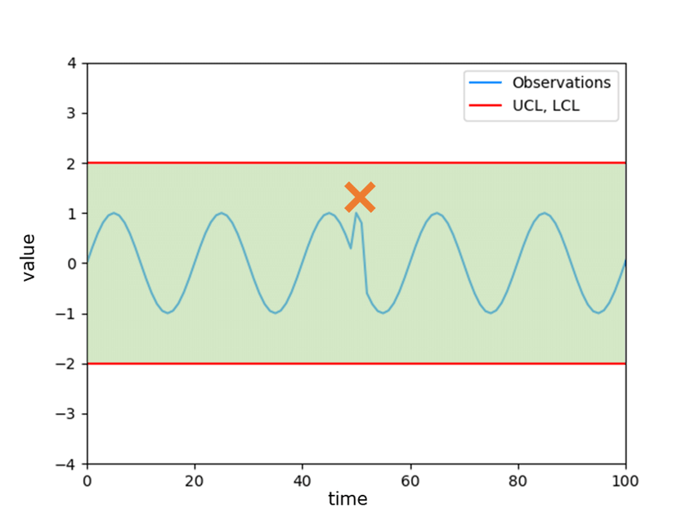
Introduction to Time-Series Anomaly Detection
Time-series data and anomaly detection
Importance of anomaly detection in healthcare

Slide 3
Healthcare Applications of Time-Series Anomaly Detection
Patient monitoring
Early disease detection
Real-time alerts

Slide 4
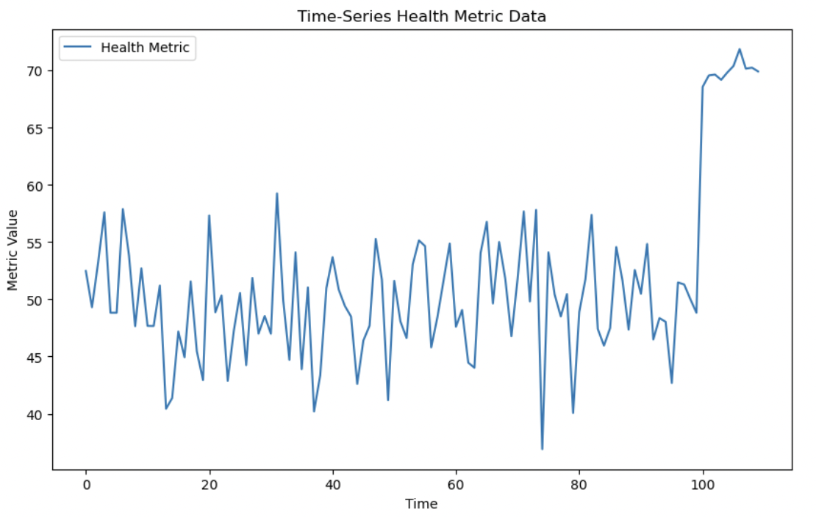
PoC: Demonstrating Anomaly Detection
Overview of the PoC: Time-series anomaly detection model built using Python and machine learning techniques.
Anomaly detection technique: Isolation Forest

Slide 5
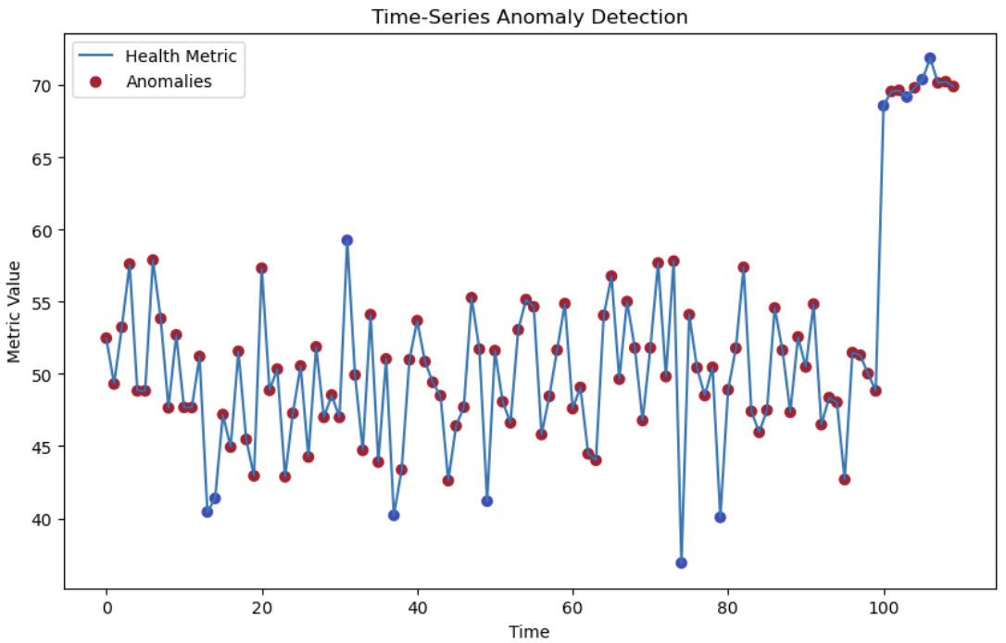
Key Features of PoC
Detect anomalies in healthcare data.
Notes:
Data preparation, model training, anomaly detection, and visualization

Slide 6
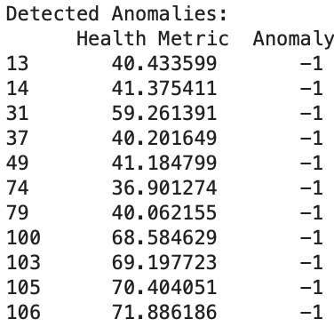
PoC Results: Detected Anomalies
Summary of the detected anomalies.
Health Metric Anomaly
13 40.433599 -1
14 41.375411 -1
31 59.261391 -1
37 40.201649 -1
49 41.184799 -1
74 36.901274 -1
79 40.062155 -1
100 68.584629 -1
103 69.197723 -1
105 70.404051 -1
106 71.886186 -1
Early detection of health issues
Notes:
(Early detection of health issues)

Slide 7
Opportunities for Cotiviti
Strategic opportunities: investment in AI-driven anomaly detection for improved healthcare services.
Potential for integrating anomaly detection into Cotiviti's clinical decision-making tools.

Slide 8
Challenges & Considerations
Next Steps
Data quality and scalability
Privacy concerns in healthcare data
Further testing, scaling PoC, and integrating with healthcare platforms
Recommendations for future research and development in time-series anomaly detection

Slide 9
Conclusion
Findings and importance of investing in anomaly detection technologies
The benefits for healthcare outcomes and operational efficiency

Slide 10
Thank you!

